Slide 1
Funding to Fight Poverty
Jayasree Mangalagiri

Slide 2
Task
To assist the NGO HELP in identifying 5 countries that can get a share of the $ 10 million funds it has raised “to fighting poverty and providing the people of backward countries with basic amenities and relief during the time of disasters and natural calamities”

Slide 3
Introduction
“By 2030, as part of the United Nations’ Sustainable Development Goals, global leaders aim to eradicate extreme poverty for all people everywhere” Ref., www.worldvision.org
Definition poverty – conditions where living is on $1.90 a day or less.
As of 2019 the following countries are the most poverty ridden countries
Syria, Zimbabwe, Madagascar, Sierra Leone and Nigeria

Slide 4
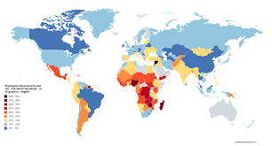
Goal
To determine which countries get the share of the 10 million dollar aid, based on their socio-economic and health data

Slide 5
What I did
The data I received had 10 different attributes describing 167 countries portfolios with respect to health and socio-economic status
I used PCA to reduce the features by 45% and eliminated multi-collinearity
There are outliers but removal of which will not be helpful hence I left them intact
I used K-Means clustering to identify a group of countries that met the requirements
I used intersection of the required features to identify the 5 countries

Slide 6
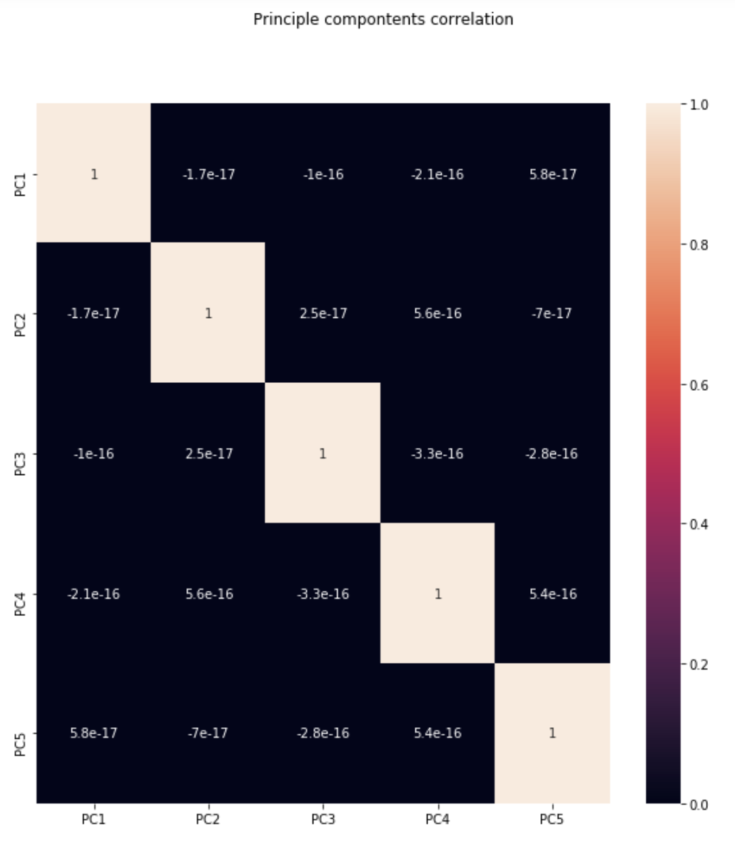
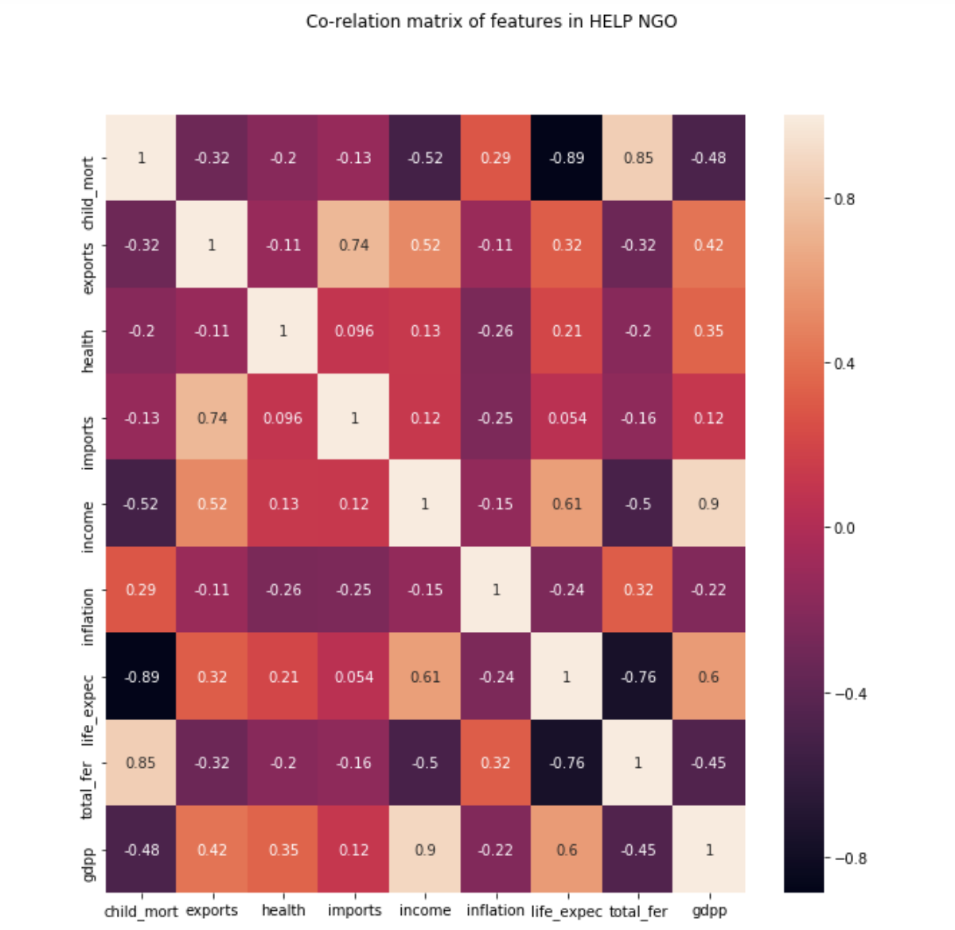
Comparison of correlation before and after PCA

Slide 7
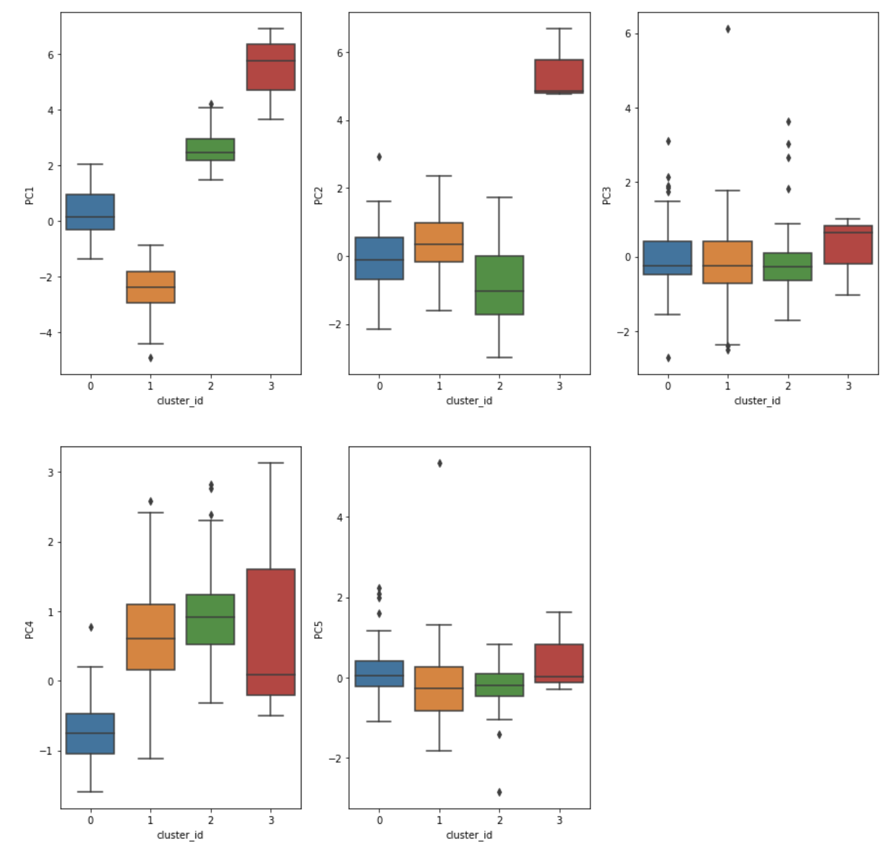
K-MeansClustering results

Slide 8
How I did it?
After PCA I used both Hierarchical and K-means clustering and compared the location of cluster means as you can see K-Means has clusters that have maximum space.
Cluster id | means of K-Mean
0 | 0.5209580838323353
1 | 0.2874251497005988
2 | 0.17365269461077845
3 | 0.017964071856287425
Cluster label | Means of Hierarchical
0 | 00.8562874251497006
1 | 0.11976047904191617
2 | 0.017964071856287425
3 | 0.005988023952095809

Slide 9
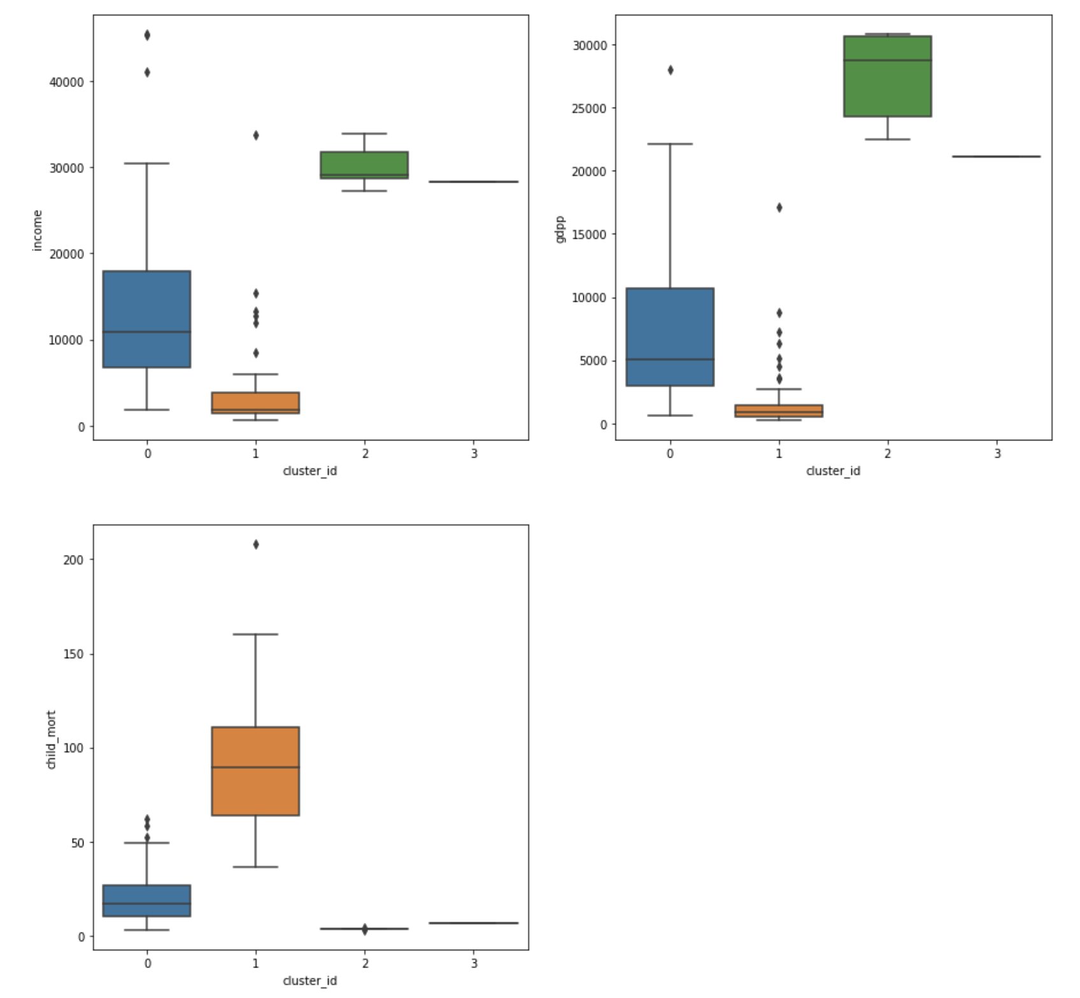
What did I find?
I found that K-means clusters with cluster Id-1 met
the requirements of having low economic conditions and
high mortality rate.

Slide 10
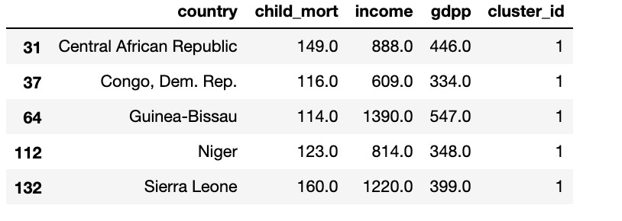
Who gets the aid?
The countires that are in dire need of the aid are
1.Central African Republic
2.Congo, Dem. Rep.
3.Guinea-Bissau
4.Niger
5.Sierra Leone

Slide 11
Recommendations
Guinea-Bissau and Sierra Leone have better income than some other countries which might mean the allocation of the budget in those countries for health care gets lower priority. We have to consider this before we actually fund these countries.

